Slide 1
PLACEMENT POLICY IN FOG COMPUTING
Team Details
A. Sai Manideep Reddy (20EG105402)
B. Harshitha (20EG105405)
K. Adithya (20EG105417)
Project Supervisor
Dr. Pallam Ravi
Assistant Professor

Slide 2
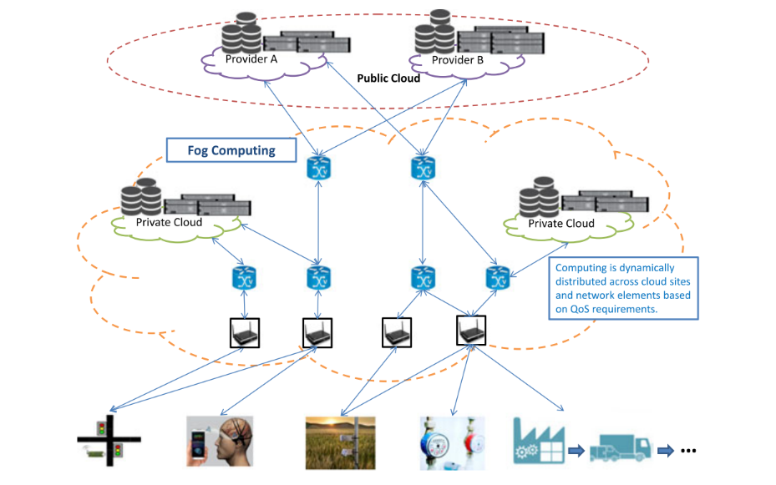
Introduction
Fog Computing is distributed computing paradigm that extents the services provided by the cloud to the edge of network.

Slide 3
Introduction
A placement policy in fog computing refers to a set of rules, algorithms, and strategies used to determine where to deploy and allocate applications, services, and resources within a fog network.
iFogSim is a popular simulation framework designed specifically for modeling and simulating fog computing environments.
The requirements to simulate a placement policy using iFogSim:
Java Development Kit (JDK) installed (required for running Java-based simulations)
Eclipse IDE
iFogSim framework
Applications of Fog Computing are Smart Cities, Smart Grids, Industrial IoT ,Smart Appliances etc,.

Slide 4
Problem Statement
Implementation of Placement Policy for minimizing the Energy Consumption in Fog Computing Environments.
Illustration of Problem:
Latency : Device to Node time+ Processing Time of node + Node to Device time
B
2ms
Strategy | Distribution | Placement | Latency Sum
1 | (1d₁, 3d₂) | A: {d₁,d₂}, B: {d₂}, C: {d₂} | 21
2 | (1d₁, 3d₂) | A: {d₂}, B: {d₁,d₂}, C: {d₂} | 26
3 | (2d₁, 2d₂) | A: {d₁}, B: {d₁,d₂}, C: {d₂} | 23
4 | (2d₁, 2d₂) | A: {d₂}, B: {d₁,d₂}, C: {d₁} | 25
C
A
2ms
2ms
2ms,2ms
3ms,3ms
1ms,1ms
1ms,1ms
2ms,2ms
1ms,2ms
Devices

Slide 5
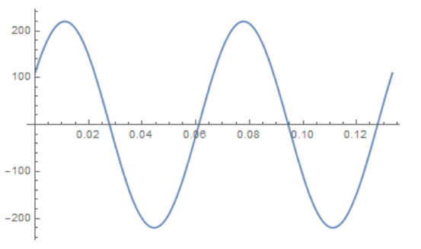
Proposed Method
The proposed method - JAYA algorithm
JAYA algorithm is an optimization algorithm, which can employed to optimize the resource allocation, task scheduling , energy efficiency, and latency minimization.
Jaya algorithm generally works in the following steps:
Problem formation
Fitness evaluation
Identify the best and worst solutions
Update the candidate solutions
Termination criteria
Repeat or Output

Slide 6
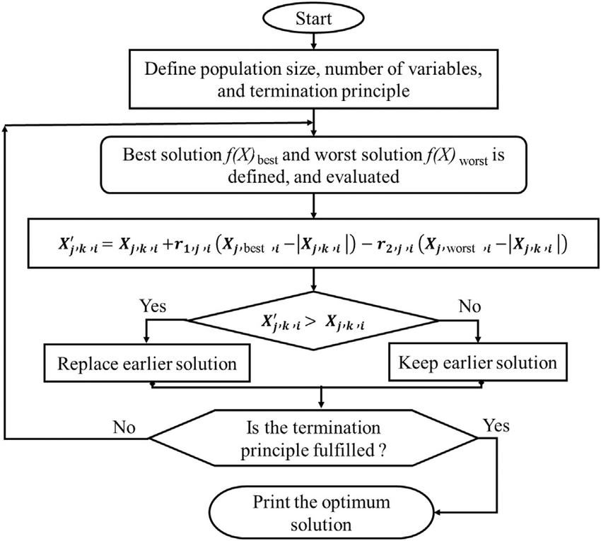

Slide 7

Proposed Method
Step 2: Evaluation of fitness values
Illustration :
Minimize(x₁+x₂)
Where -100<= x₁ <=100
-100<= x₂ <=100
Population | x₁ | x₂ | F(x)
1 | 20 | -10 | 10
2 | 58 | -28 | 30
3 | -22 | 29 | 7
4 | -1 | 2 | 1
Step 1: Initialize population
$$\left[\begin{aligned}20 −10 \\ 58 −28 \\ −22 29 \\ −1 2\end{aligned}\right]$$
Step 3: Identify the best and worst solutions
Population | x₁ | x₂ | F(x)
1 | 20 | -10 | 10
2 | 58 | -28 | 30
3 | -22 | 29 | 7
4 | -1 | 2 | 1
Worst
Best

Slide 8
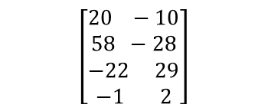
Step 4: Modify and update the candidate solution
X_{new}=X_{j,k}+r₁(X_{best}-|X_{j,k}|)-r₂(X_{worst}-|X_{j,k}|)
x₁
r₁ | r₂
0.0348 | 0.9307
x₂
r₁ | r₂
0.9045 | 0.5900
$$\left[\begin{aligned}20 −10 \\ 58 −28 \\ −22 29 \\ −1 2\end{aligned}\right]$$
58 | -28
-1 | 2
Worst
Best
X₁₁=X_{1,1}+r₁(X_{best}-|X_{1,1}|)-r₂(X_{worst}-|X_{1,1}|)
X₁₁=20+(0.0348(-1-|20|))-(0.9307(58-|20|))
= -16.0974
X₃₁=-22+(0.0348(-1-|-22|))-(0.9307(58-|-22|))
= -56.3056
X₁₂=-10+(0.9045(2-|-10|))-(0.5900(-28-|-10|))
= 5.184
X₃₂=29+(0.9045(2-|29|))-(0.5900(-28-|29|))
= 38.2085
X₂₁=58+(0.0348(-1-|58|))-(0.9307(58-|58|))
= 55.9468
X₂₁=-1+(0.0348(-1-|-1|))-(0.9307(58-|-1|))
= -54.1195
X₂₂=-28+(0.9045(2-|-28|))-(0.5900(-28-|-28|))
= -18.477
X₄₂=2+(0.9045(2-|2|))-(0.5900(-28-|2|))
= 19.7

Slide 9
Population | x₁ | x₂ | F(x)
1 | -16.0974 | 5.184 | -10.9134
2 | 55.9468 | -18.477 | 37.4698
3 | -56.3096 | 38.2085 | -18.1011
4 | -54.1195 | 19.7 | -34.4195
F(X_{new})<F(X_{old}) [Minimization]
Then update the solution otherwise preserve the old one .
Population | x₁ | x₂ | F(x)
1 | 20 | -10 | 10
2 | 58 | -28 | 30
3 | -22 | 29 | 7
4 | -1 | 2 | 1
Population | x₁ | x₂ | F(x)
1 | -16.0974 | 5.184 | -10.9134
2 | 58 | -28 | 30
3 | -56.3096 | 38.2085 | -18.1011
4 | -54.1195 | 19.7 | -34.4195
Step 5: Termination criteria
Step 6: Output

Slide 10
Experiment Environment
Eclipse IDE: Using this, we created a Java project with the iFogSim simulation framework.
iFogSim is a well-known simulation framework designed specifically for modeling and simulating fog computing environments with a variety of applications.
We used them to test the VRgame.

Slide 11
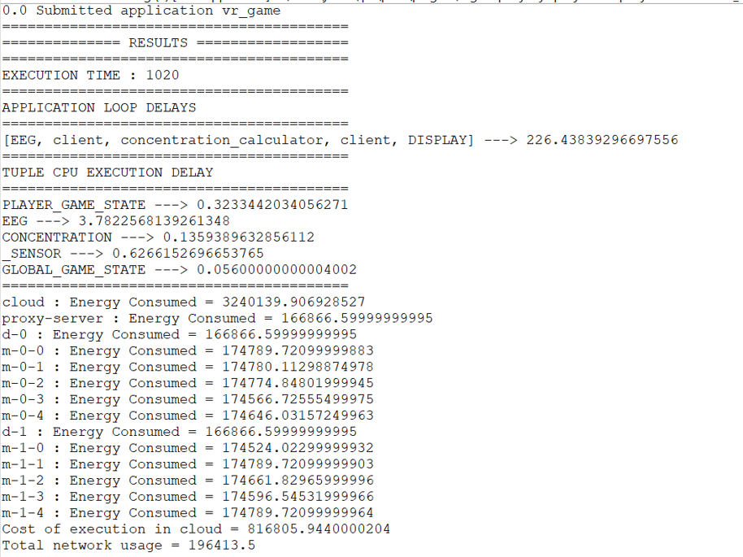
Experiment Screenshots
Cloudonly

Slide 12
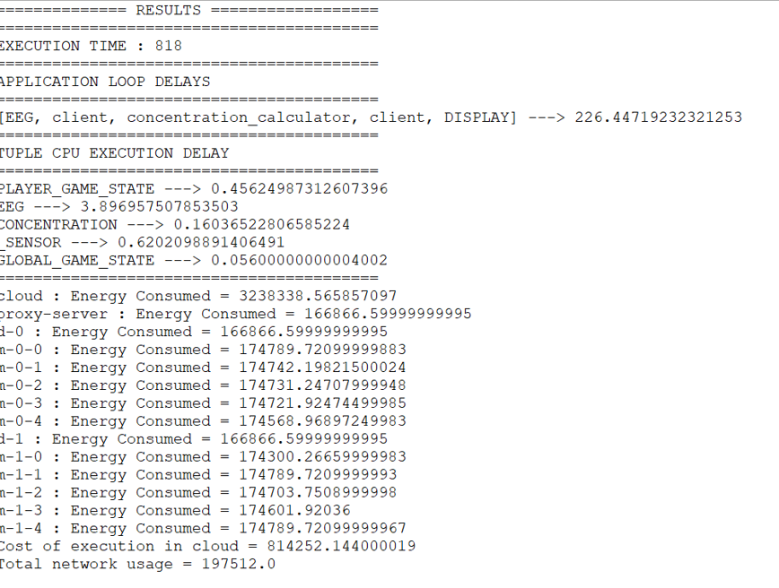
Experiment Screenshots
PSO

Slide 13
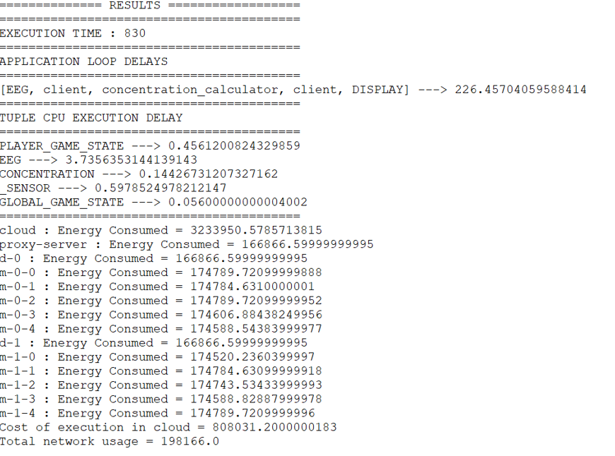
Experiment Screenshots
EPSO

Slide 14
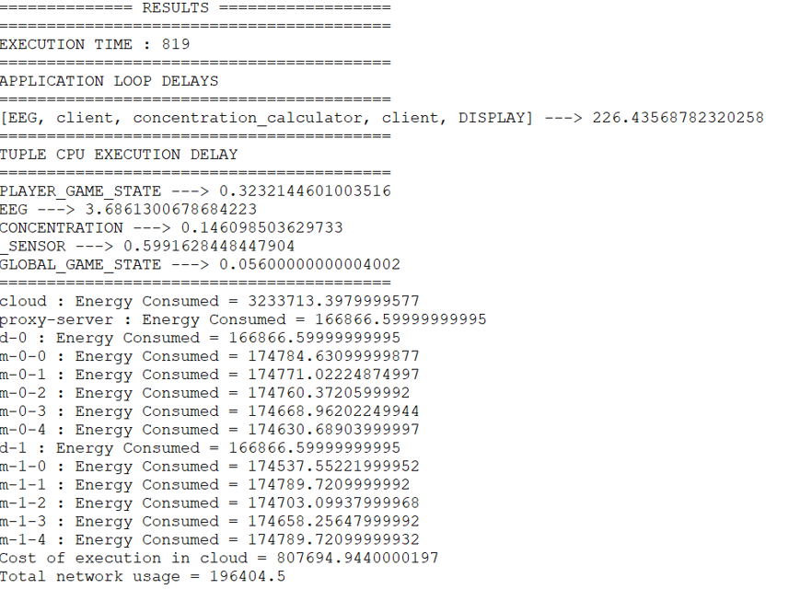
Experiment Screenshots
JAYA

Slide 15
Experiment Results

Slide 16
Findings
We have discovered that we can minimize latency and lower energy usage by implementing adjustments to the placement policies in the fog computing environment.

Slide 17
Justification
Parameters
Low latency and Energy consumption
Formula
Latency : Device to Node time+ Processing Time of node + Node to Device time
Total Energy Consumed = Energy consumed by Module ₁+ Energy consumed by Module ₂+….+ Energy consumed by Module _{N}
In what way the parameters are improved
PSO (parameters) : Inertia weight , Social and Cognitive components.
EPSO (parameters) : Local search mechanism and Inertia weight.
JAYA (parameters) : No specific parameters apart from common parameters like no. of iterations, Population size.

